Slide 1
The lecture will start at 9:30am EDT
Sli.do event code: 3462912

Slide 2
CS4501: Introduction to Reinforcement Learning
Course Policy
Hongning Wang
CS@UVA
http://www.cs.virginia.edu/~hw5x/Course/RL2022-Fall/_site/

Slide 3


Instructor
Hongning Wang
  Graduated from University of Illinois at Urbana-Champaign in 2014

Slide 4
Instructor
Hongning Wang
  Research area
    Information retrieval
    Data mining
    Machine learning
  Industry experience
    Google
    Microsoft Research
    Snap
    Alibaba
My main application areas of reinforcement learning

Slide 5
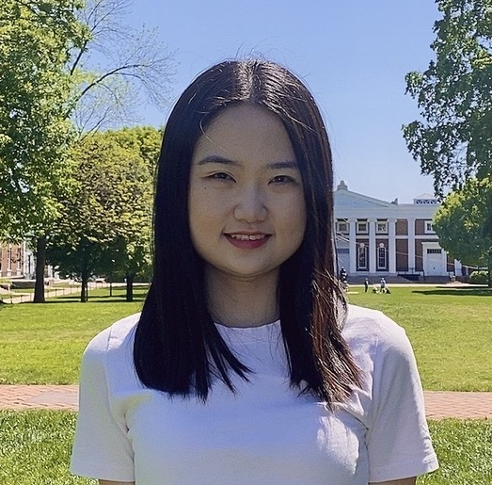
Teaching assistant
Wanyu Du (wd5jq@virginia.edu)
  Research area
    Machine learning
    Natural language processing

Slide 6

Teaching assistant
Fan Yao (fy4bc@virginia.edu)
  Research area
    Machine learning
    Algorithmic game theory

Slide 7
How about you?
Why do you choose this course?
Let’s practice sli.do!

Slide 8
Course delivery
In-person and online
  Time: Tu/Th 9:30am to 10:45am, eastern time
  Location: Thornton Hall E303
  Via Zoom meetings
    Meeting links can be found on Collab
    Recordings will be posted on Collab after each class
  Office hours
    Instructor: Tu/Th 4pm-5pm, by Zoom, no recordings
    TA: We/Fr 2pm-3pm, by Zoom, no recordings
    Please make an appointment beforehand
    Additional appointments can be requested via email

Slide 9
Course delivery
Tools
  Zoom
    All meeting links can be found on Collab
  Piazza
    Announcements and after-class discussions
    https://piazza.com/virginia/fall2022/cs450120055
  Slido (sli.do)
    A web-based interactive Q&A and polling platform
    In-class discussions
    An event page will be created prior to each of our class

Slide 10
Positioning of this course
An introductory course about reinforcement learning
  We will broadly cover important topics in reinforcement learning, starting from multi-armed bandits, to Markov Decision Process, planning, on-policy and off-policy learning, and its recent development under the context of deep learning

Slide 11
Positioning of this course
We have strong (pre-)assumptions
  You already have solid background in machine learning, math, and computer programming
  You do not need to have good familiarity with reinforcement learning
    Can you name any reinforcement learning algorithms?

Slide 12
Goal of this course
Discuss fundamental problems and state-of-the-art solutions in reinforcement learning
  Wide coverage of important reinforcement learning techniques
Get hands-on experience by solving practical problems
Prepare students for doing cutting-edge research in reinforcement learning and related fields

Slide 13
Structure of this course
Nine major topics will be covered by lectures
  Multi-armed bandit
  Markov decision process
  Dynamic programming
  Monte Carlo methods
  Temporal-Difference learning
  Policy gradient methods
  Approximation methods
  Deep reinforcement learning
  Offline reinforcement learning

Slide 14

Textbook
Reinforcement Learning: An Introduction
  Second Edition
  By Richard S. Sutton and Andrew G. Barto, MIT Press

Slide 15
Prerequisites
Math – Vital!
  Probability
    Discrete/continuous distributions, expectation, moments
  Linear algebra
    Vector, matrix, matrix operations
  Optimization
    Gradient-based methods

Slide 16
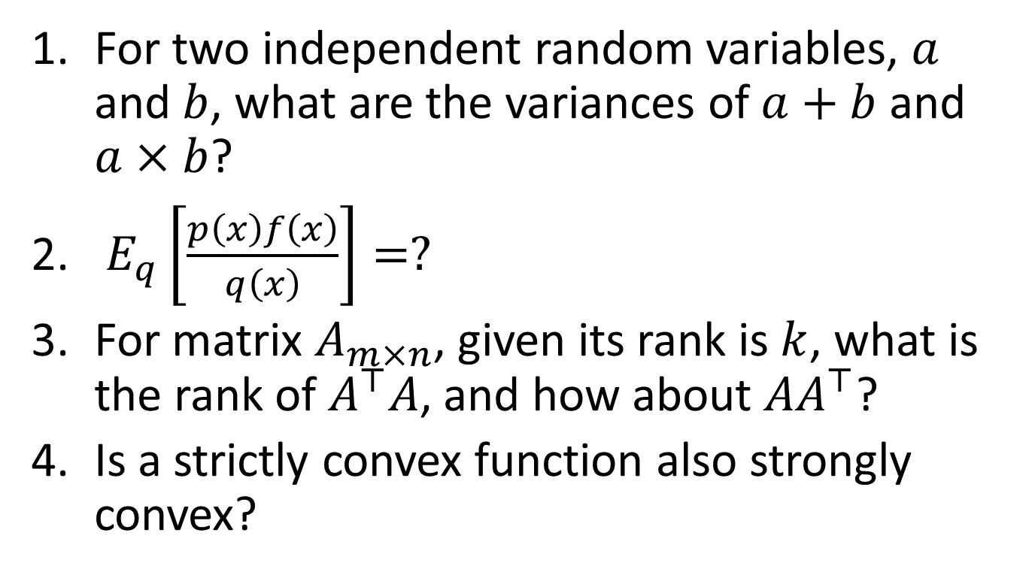
Pop-up quiz - math
For two independent random variables, $a$ and $b$, what are the variances of $a+b$ and $a×b$?
$E_{q}\left[\frac{p\left(x\right)f\left(x\right)}{q\left(x\right)}\right]=?$
For matrix $A_{m×n}$, given its rank is $k$, what is the rank of $A^{⊤}A$, and how about $AA^{⊤}$?
Is a strictly convex function also strongly convex?

Slide 17
Prerequisites
Machine learning – Crucial!
  CS 4774/6316 or equivalent
  Supervised machine learning
    Regression, classification, active learning

Slide 18
Pop-up quiz - ML
What is the so-called “variance-bias trade-off”?
What is the main difference between classification and regression problems?
Can L2 regularization make your solution sparse?
Does stochastic gradient descent converge faster than gradient descent for a convex function?

Slide 19
Prerequisites
Programming skills – Important!
  Basic data structures: CS 2150 or equivalent
  Python is required for machine problems
    Most open source packages are written in Python
  Any language you choose for the rest of this course

Slide 20
Pop-up quiz - programming
What is the time complexity of using dynamic programming to find the longest common subsequence between two sequences? How about its space complexity?
What is the time complexity of the insertion operation in a binary search tree?

Slide 21

Character of this course
Discussion oriented and heavy
  This is how great ideas are created!
  You are encouraged to express your thoughts, confusions, and suggestions
  Focusing on why, rather than just how

Slide 22

Assessment
Paper review (10%)
  Review ICLR’2023 submissions!
Homework (36%)
  Machine problems (~3)
In-class quizzes (24%, ~4)
  True/False, multiple choices, short answers
Course project (40%)
  Last week of semester
  Performed in groups
fairness will be guaranteed by the instructor
No curving will be applied!

Slide 23
Assessment
Bonus for exceptional participation?
  But how to quantify this?

Slide 24
Paper review
An experiment this year!
Practice scientific peer review
  Let’s review ICLR’2023 submissions
Choose a submission in the area of reinforcement learning
Follow ICLR review guideline to finish your review
Post on Piazza and get peer-evaluated
Exceptional reviews are encouraged to submit to ICLR’2023 official review system for bonus points

Slide 25
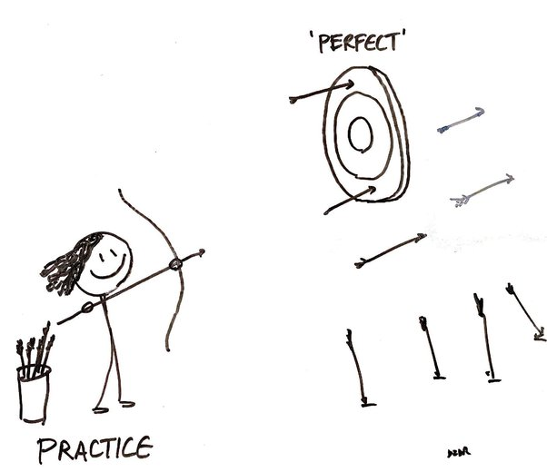
Machine problems
To be finished by each student individually
  Two weeks for each assignment
  Sharing implementations is not allowed
  Discussions with your peers or on Piazza are encouraged

Slide 26

In-Class Quizzes
To be implemented via collab
  15 minutes each
  Date will be announced one week ahead
  Non-overlapping coverage of content discussed in our lectures

Slide 27
Course project
Topics
  You have the full freedom; but convince your peers and instructor first!
Teamwork
  2-3 students per group
Evaluation
  Proposal: maximum 4 pages (25%)
  15-minutes in-class presentation (40%)
  Written report: maximum 8 pages (35%)
In required templates!

Slide 28

Course project
Team formation
  Post your sales pitch on Piazza to find your teammates before Sept. 22nd
    Explain why we should be excited about your idea
    Required for everyone

Slide 29

Late policy
Homework
  Submit via Collab
  Grace period
    You have free 7 late days in total for all assignments.
    You can use late days for any assignments. A late day extends the deadline 24 hours.
    Once you have used all 7 late days, the penalty is 10% for each additional late day (until 0 points left).
Course project
  Submit via Collab
  Proposal is due by the end of 7th week (Oct. 7th)
  Final report is due by the last day of semester (Dec. 14th)
Discuss with the instructor about your project idea at least one week before this due date

Slide 30



Classroom participation
HIGHLY APPRECIATED!
  Helps me quickly remember your names
  Reminds me what is still confusing
  You drive the lecture/discussion in this class!

Slide 31
Questions?
Thank you!

Slide 32

Warm up exercise:
Is reinforcement learning supervised machine learning?

